Slide 1


Stock market game
Better Cheating Through Machine Learning

Slide 2

What is the stock market game?
Simple educational tool used by business and economics teachers for introductory level classes.
Pick three different publically traded companies.
Students are given an arbitrary amount of “money” to invest in each.
Students are expected to track their three companies prices over an arbitrary length of time.
At the end, students are expected to write a report detailing their successes and failures, as well as what the experience taught them.

Slide 3

The lesson:
STOCKS ARE HARD TO PREDICT

Slide 4


Or are they?
Yes. Yes they are.
Which is why I’m going to cheat.

Slide 5
Good stock picks

Slide 6
What to look for in a company
Some industries are more stable than others.
Less stable industries can offer bigger yields.
A good company that has been operating for decades is typically a safer bet.
The goal should always be to find the company that is growing steadily, not quickly, but isn’t valued at too high share price.
Consider the time frame you’re working with for the game.
Short term “investment” periods can benefit tremendously from riskier properties, assuming no major events occur to sink the price.
Consider the “money” granted to you at the start of the game. Lower dollar amounts won’t benefit much from risky cheap companies.

Slide 7
How to “cheat” with machine learning
The problem:
The solution:
Ultimately the whole game comes down to identifying which company is going to have their price increase the most in the shortest amount of time.
As such, the stock market game is a game of prediction.
Most predictive methods however are unreliable as tarot cards, crystal balls and fortune cookies tend to do little better than CNBC and haruspex is frowned upon.
Math!
More specifically getting a computer to do a lot of math for me.
I’m talking about Machine Learning.
Honestly it’s not like I’m really teasing anything here, it says it up at the top of this slide.
We’re going to use computers to help give us an edge and “cheat” at the stock market game.
Took me long enough to get here.

Slide 8
First, the companies

Slide 9

For simplicities sake I just chose 3 companies more or less at random.
However they are all involved in banking and finance as those tend to be reliable for investors.

Slide 10

Goldman sachs -GS
Founded 1869
Primarily focused on investments and trade
Primary dealer in the U.S. Treasury Market
Has a diverse portfolio like any good stock portfolio should be

Slide 11
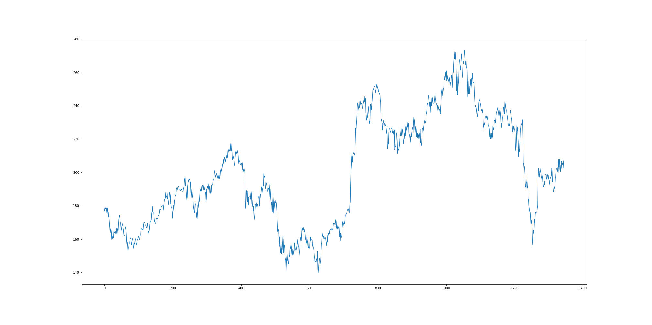
GS Performance 2014 to 2019

Slide 12
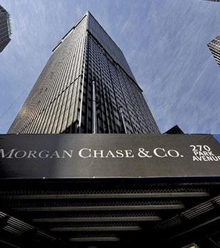
JP Morgan Chase & co. -JPM
Founded 1799.
6th largest bank in the world.
Has acquired more than 30 other banks over the course of it’s 200 year history.
CEO Jamie Dimon received $30 million in compensation for the year 2018

Slide 13
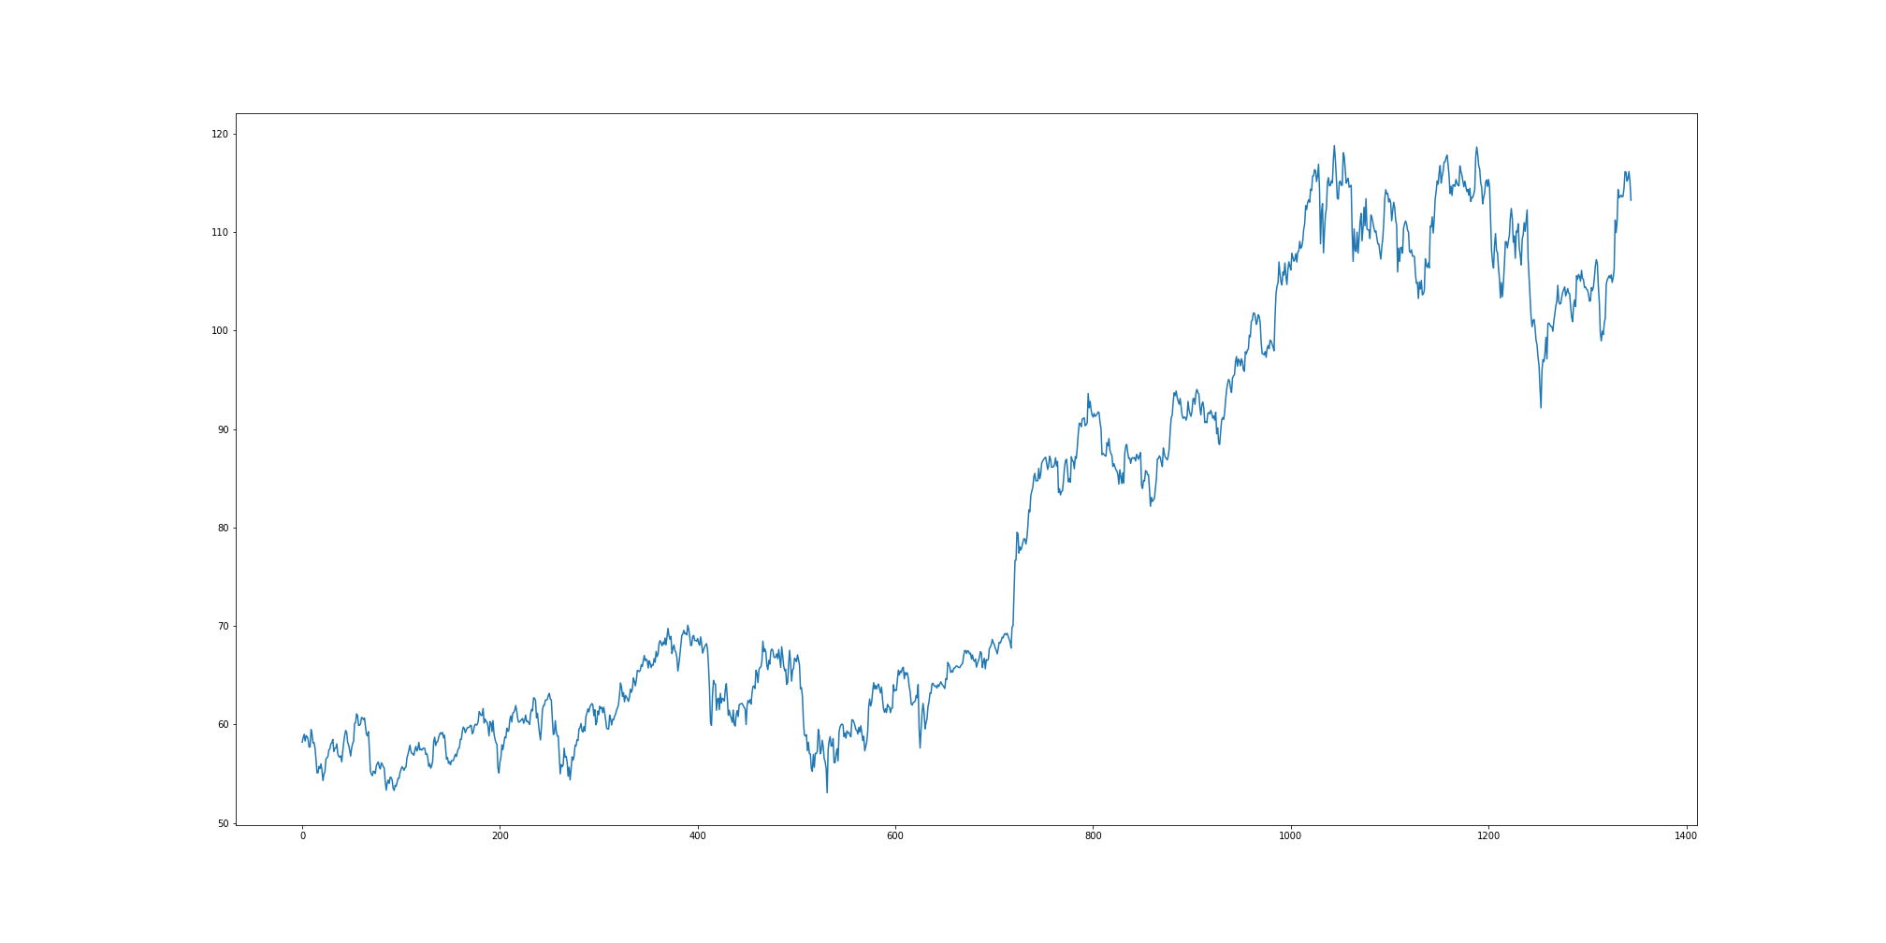
JPM performance 2014 to 2019

Slide 14


VISA - V
Founded 1959
Originally owned by Bank of America as their BankAmericard credit card
The first all purpose credit card
Became it’s own entity in 1976 to better deal with international clients and regulatory entities.

Slide 15
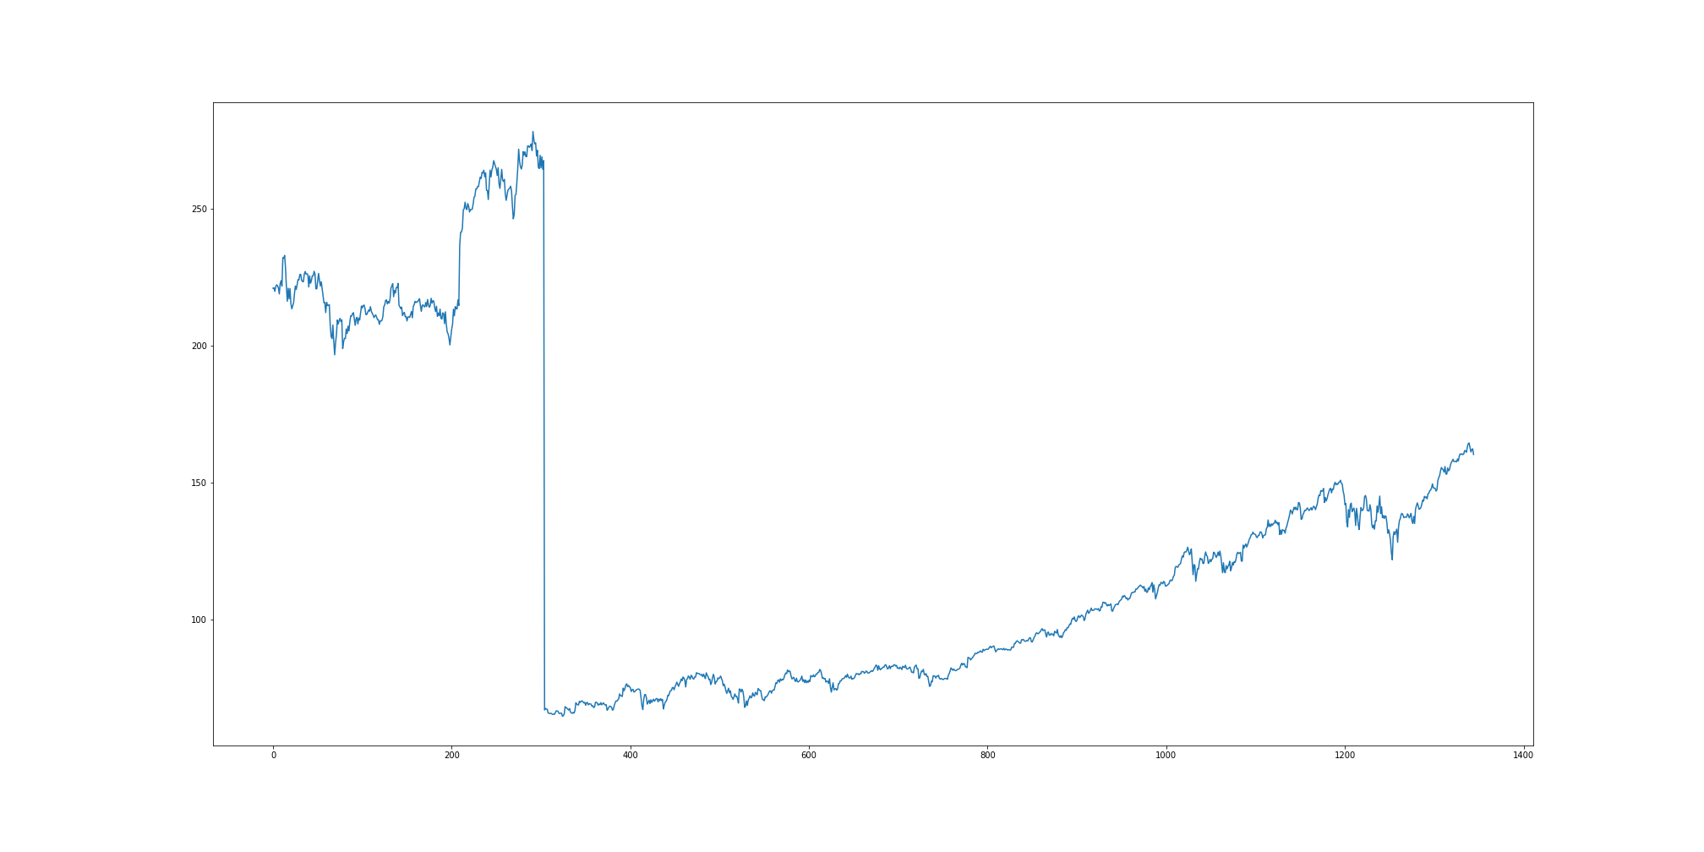
V performance 2014 to 2019
March 18, 2015 Visa split it’s stock 4 ways causing the shocking nosedive you see here.

Slide 16
How to teach a machine
It takes patience.

Slide 17
Linear Regression
Simple supervised learning
Ideal for stable growth metrics that should continuously appreciate in value
Great for tracking housing prices, short-term population growth, soil erosion, and other projects.

Slide 18
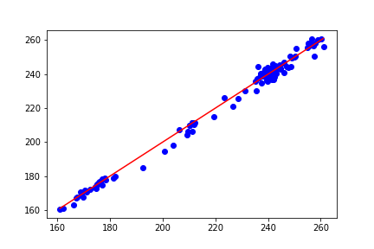
GS in a linear Regression model
This model tracks Q4 closing prices for the fiscal years 2016, 2017, and 2018.
Solid growth with prices clustering neatly along a single slope.
This model correlation score is .99, suggesting 99% accuracy.

Slide 19
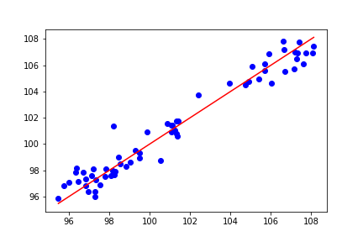
JPM in a linear regression model
Tracking Q4 2016, 2017, and 2018.
Less stable, data points are clustered to one side or the other around 100.
This model correlation score is .95, suggesting 95% accuracy.

Slide 20
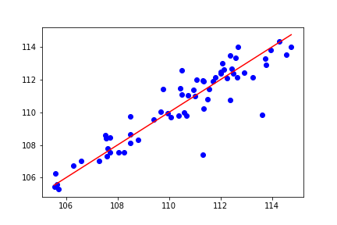
V in a linear regression model
Just all over the place.
Data points rest loosely around the line of best fit.
This model correlation score is .84, suggesting 84% accuracy.

Slide 21
Not bad, but not great either
Unfortunately other than showing what range can be expected from these companies performance, none of these linear regression charts help us with predictions.
Each of these cannot yield us a particular date, nor do they allow us to predict fluctuations in the stock price.
Investing in the stock market can be a lot of things to a lot of people. Warren Buffet recommends that the best time to sell your shares is never, suggesting instead that you invest in a high dividend company and just let your money grow along with the company you’ve invested in.
But we’re playing a game here and have a time limit. These graphs show us that the price will grow over time, but doesn’t reflect how over any particularly good series of time.

Slide 22
Long short-term memory
Artificial Recurrent Neural Network.
Good for tracking large numbers and big datasets.
A simpler model, used for handwriting recognition, speech recognition, and (conveniently) stock market analysis and prediction.

Slide 23
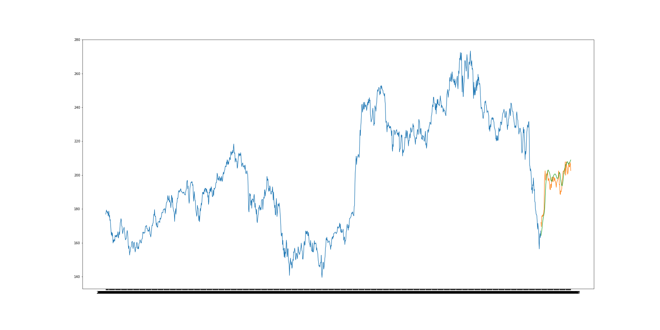
GS LSTM 2014 to 2018
Blue line represents the price over the period of time.
Green line is the LSTM models predictions.
Orange line is actual prices for the last 60 days of 2018

Slide 24
Date | Predicted | Actual
1/2/2019 | 164.2536 | 172.03
1/3/2019 | 165.5204 | 169.51
1/4/2019 | 166.7851 | 175.05
1/7/2019 | 168.6678 | 176.02
1/8/2019 | 170.7388 | 175.37
1/9/2019 | 172.5342 | 176.47
1/10/2019 | 174.1127 | 176
1/11/2019 | 175.3025 | 176.93
1/14/2019 | 176.2779 | 178.72
1/15/2019 | 177.275 | 179.91
1/16/2019 | 178.3191 | 197.08
1/17/2019 | 181.7655 | 199.09
1/18/2019 | 186.1983 | 202.54
1/22/2019 | 191.0398 | 197.68
1/23/2019 | 194.6577 | 196.9
1/24/2019 | 197.0769 | 197.8
1/25/2019 | 198.7186 | 200.74
1/28/2019 | 200.2039 | 199.72
1/29/2019 | 201.2347 | 200.5
1/30/2019 | 202.0342 | 202.48
1/31/2019 | 202.9146 | 198.01
Initial Test RSME = 232.76
Predictive Root Square Mean Error = 7.09

Slide 25
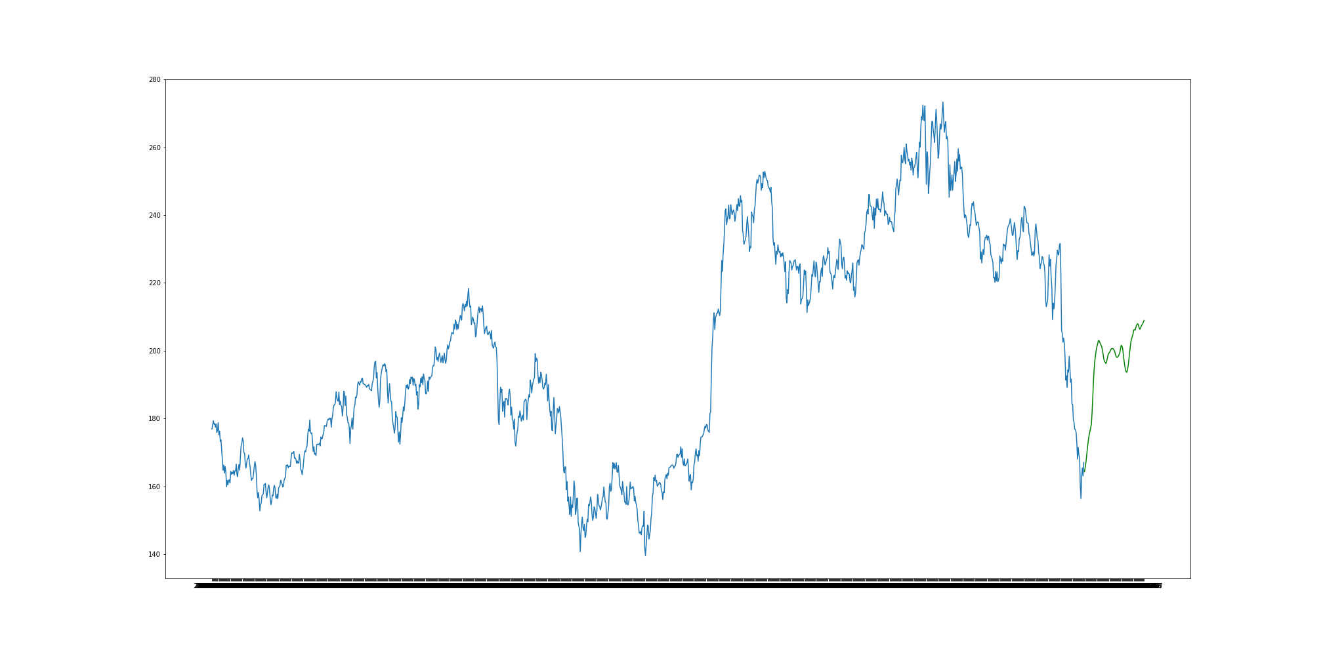

Slide 26
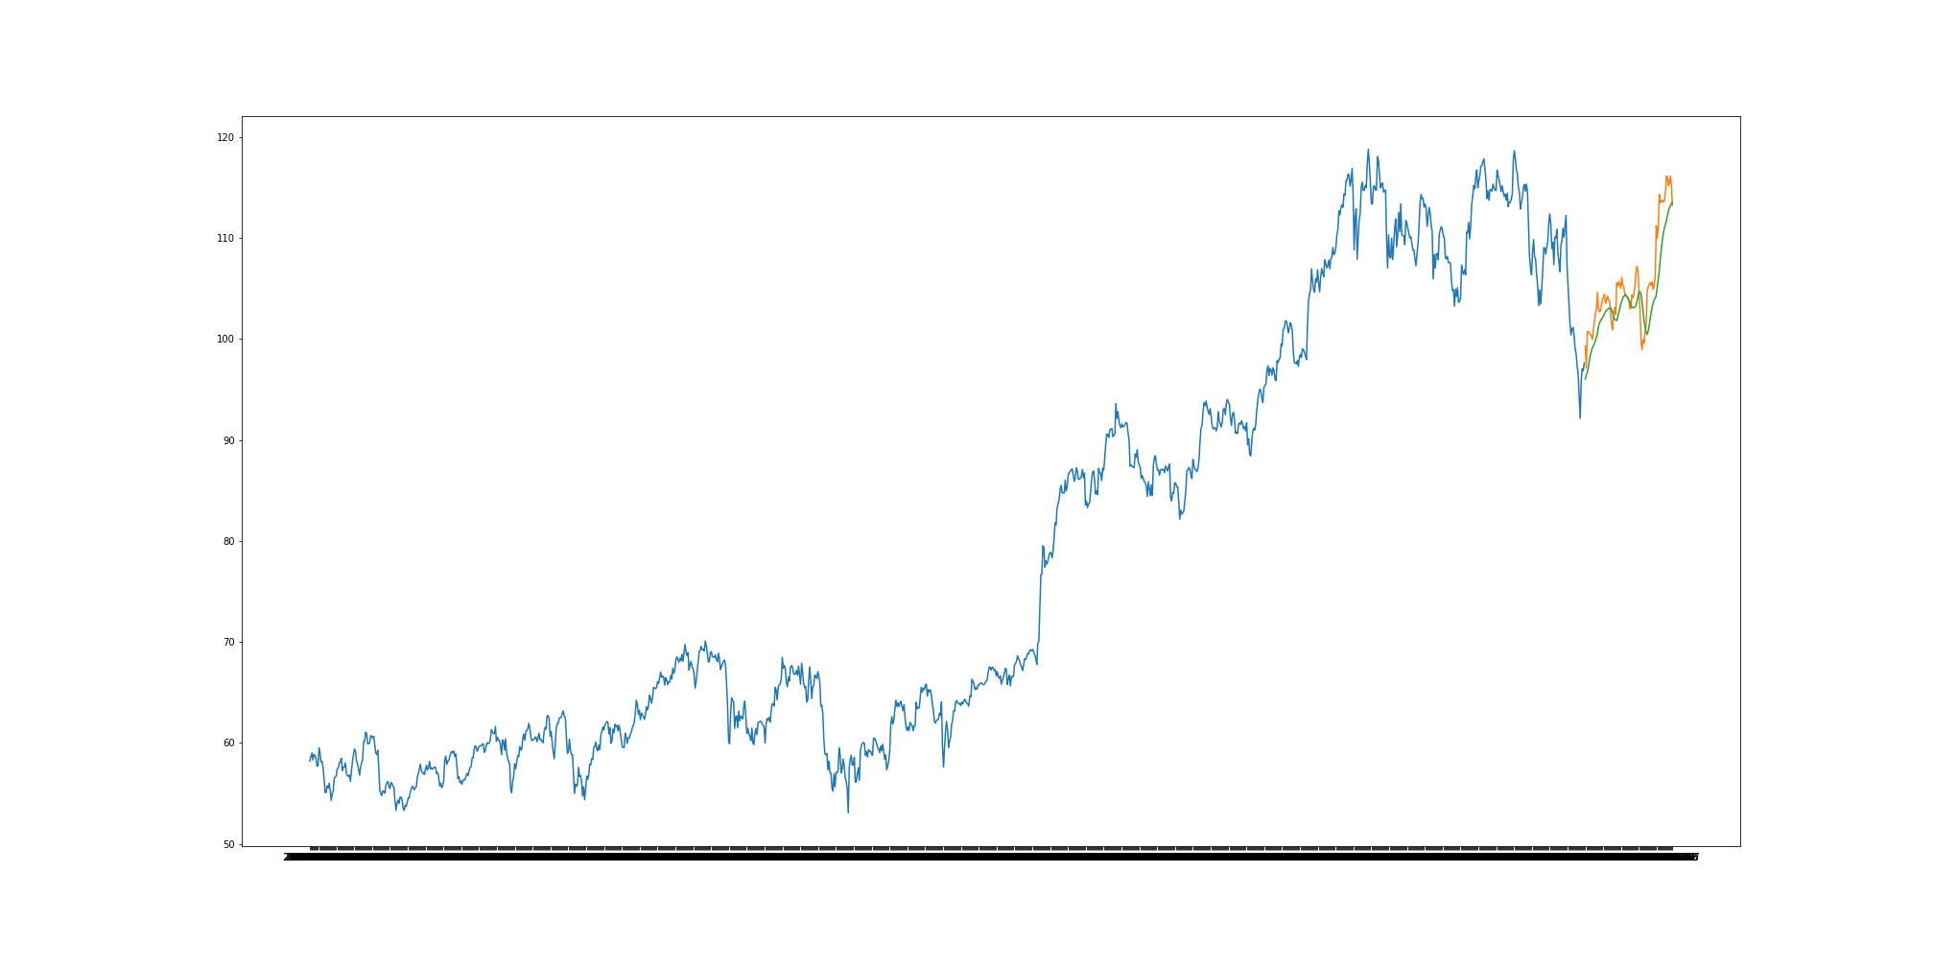
JPM LSTM 2014 to 2018
Blue line represents the price over the period of time.
Green line is the LSTM models predictions.
Orange line is actual prices for the last 60 days of 2018

Slide 27
Initial Test RMSE = 109.05
Predictive Root Mean Square Error = 2.77
Date | Predicted | Actual
1/2/2019 | 96.01147 | 99.31
1/3/2019 | 96.42322 | 97.11
1/4/2019 | 96.64889 | 100.69
1/7/2019 | 97.1946 | 100.76
1/8/2019 | 97.80622 | 100.57
1/9/2019 | 98.3586 | 100.4
1/10/2019 | 98.79945 | 100.39
1/11/2019 | 99.1337 | 99.91
1/14/2019 | 99.31945 | 100.94
1/15/2019 | 99.53562 | 101.68
1/16/2019 | 99.81682 | 102.5
1/17/2019 | 100.1868 | 102.92
1/18/2019 | 100.5991 | 104.59
1/22/2019 | 101.1779 | 102.94
1/23/2019 | 101.5588 | 102.68
1/24/2019 | 101.788 | 102.74
1/25/2019 | 101.9249 | 103.39
1/28/2019 | 102.0763 | 103.88
1/29/2019 | 102.2679 | 104.17
1/30/2019 | 102.4868 | 104.41
1/31/2019 | 102.7198 | 103.5

Slide 28
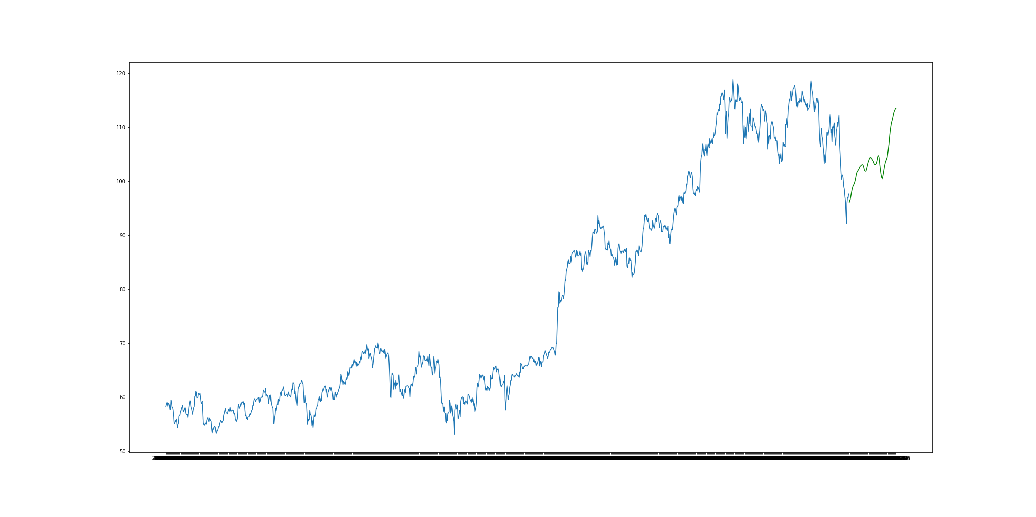

Slide 29
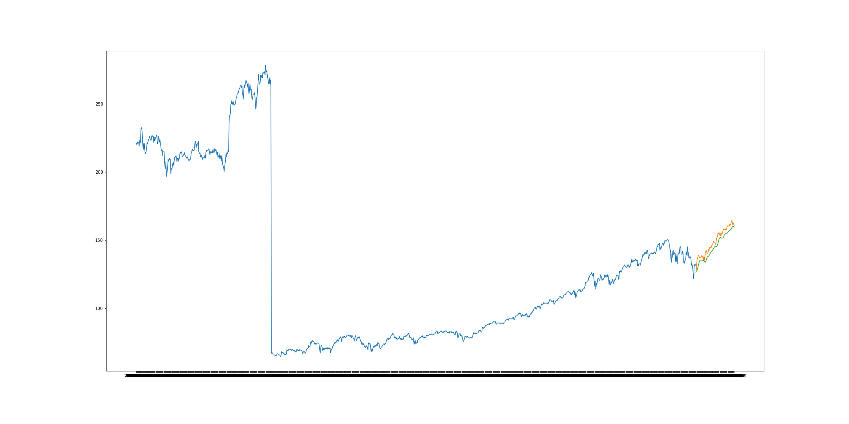
V LSTM 2014 to 2018
Blue line represents the price over the period of time.
Green line is the LSTM models predictions.
Orange line is actual prices for the last 60 days of 2018

Slide 30
Initial Test RMSE = 136.92
Predictive Root Mean Square Error = 5.04
Date | Predicted | Actual
1/2/2019 | 130.9377 | 132.92
1/3/2019 | 131.8128 | 128.13
1/4/2019 | 131.7748 | 133.65
1/7/2019 | 132.2426 | 136.06
1/8/2019 | 133.221 | 136.8
1/9/2019 | 134.3695 | 138.41
1/10/2019 | 135.6571 | 138.67
1/11/2019 | 136.8224 | 138.06
1/14/2019 | 137.6322 | 137.1
1/15/2019 | 137.9902 | 137.34
1/16/2019 | 138.1322 | 137.34
1/17/2019 | 138.1578 | 137.28
1/18/2019 | 138.1243 | 138.5
1/22/2019 | 138.2798 | 138.05
1/23/2019 | 138.4214 | 137.01
1/24/2019 | 138.3704 | 137.7
1/25/2019 | 138.3677 | 138.67
1/28/2019 | 138.5506 | 135.99
1/29/2019 | 138.3433 | 135
1/30/2019 | 137.8506 | 137.6
1/31/2019 | 137.7522 | 135.01

Slide 31
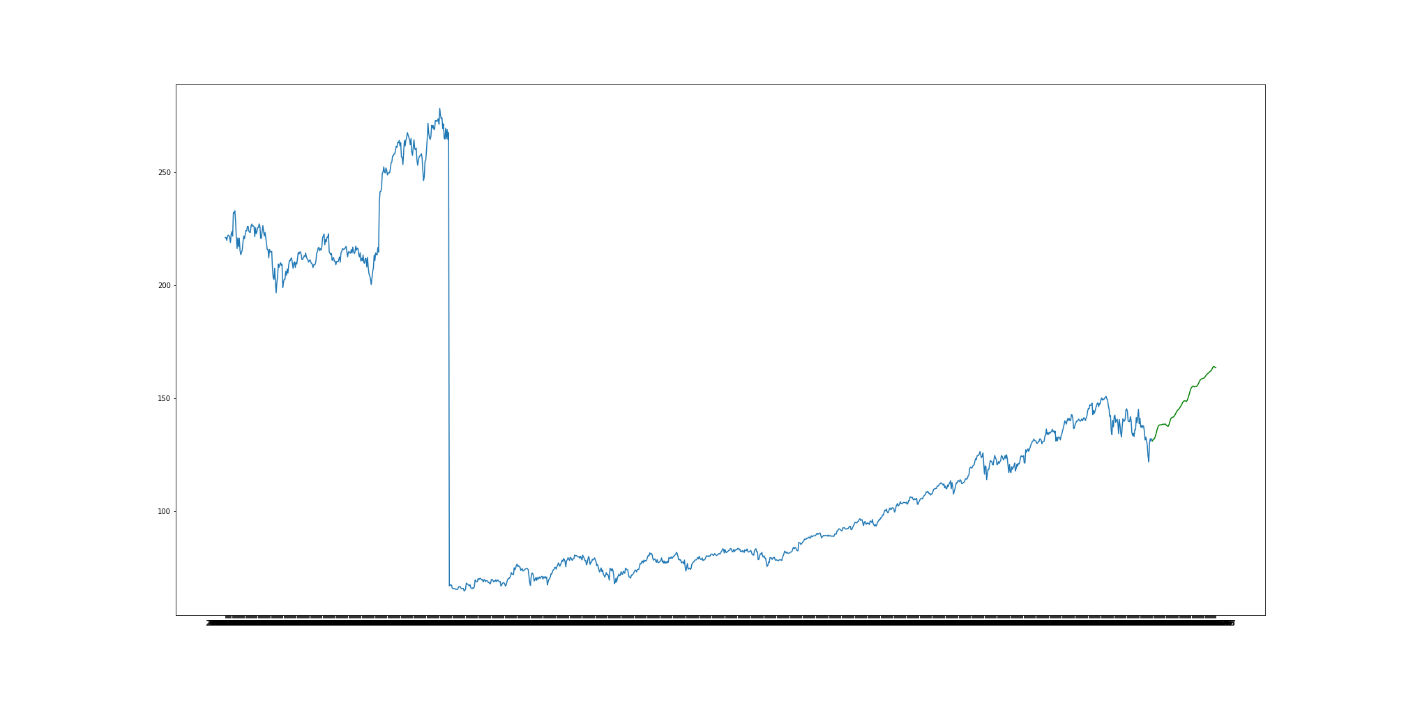

Slide 32

What good is all this

Slide 33

GS, JPM, and V are all profitable stocks
Each of the three companies examined here experienced gains of around 10% (estimated) over the course of a simple 5 month period here in 2019.
Though not predicted accurately, the model did predict a comparable growth.
Because of the growth, any student to choose any of these three companies would have seen a net profit and an appreciation for capital gains tax come next year.
No, you cannot get predictions for the next 6 months.

